Slide 1
Machine-Independent
Operating System Features

Slide 2
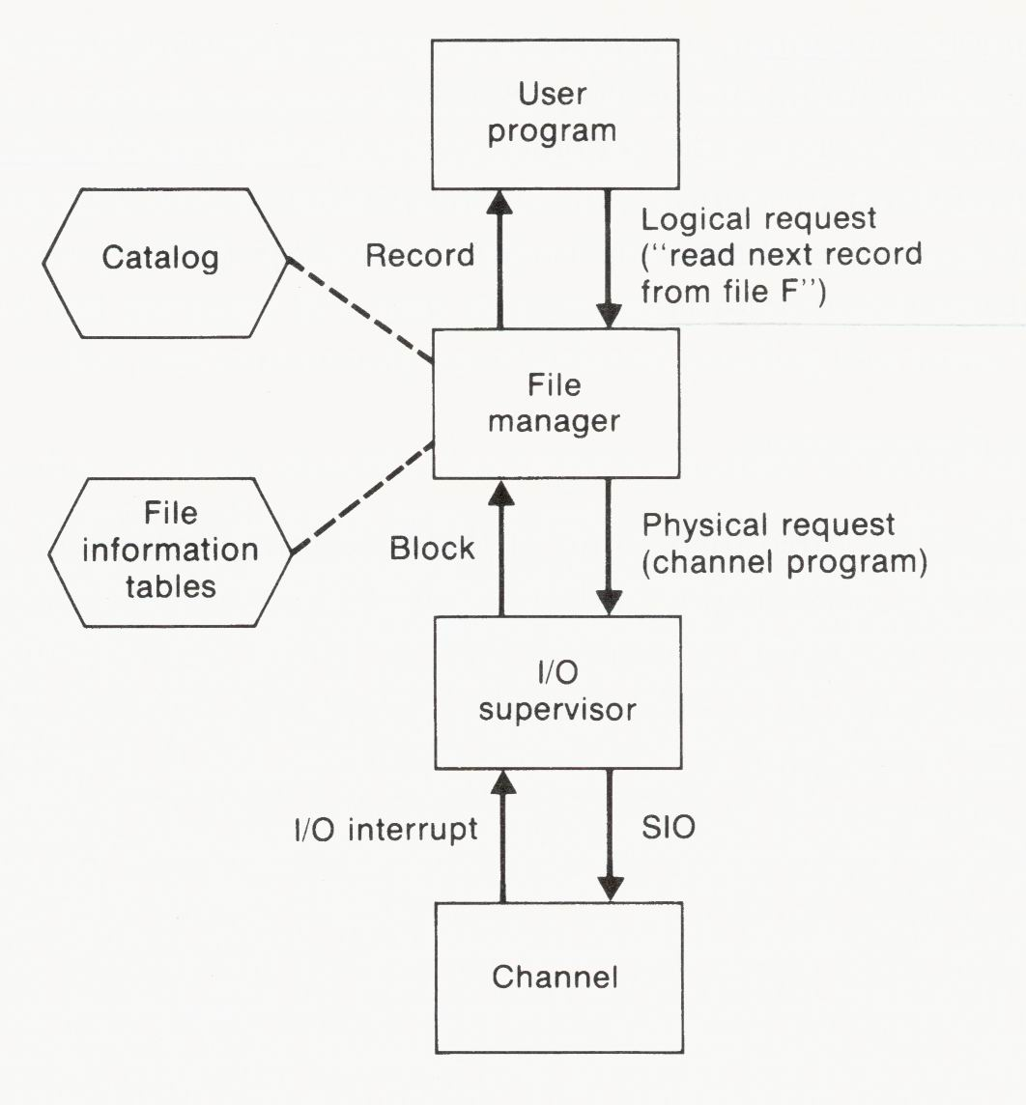
File Processing
Opening
  Search the catalog
  Locate the appropriate file information table
  Create buffer
Closing
  Delete buffers
  Delete work areas

Slide 3
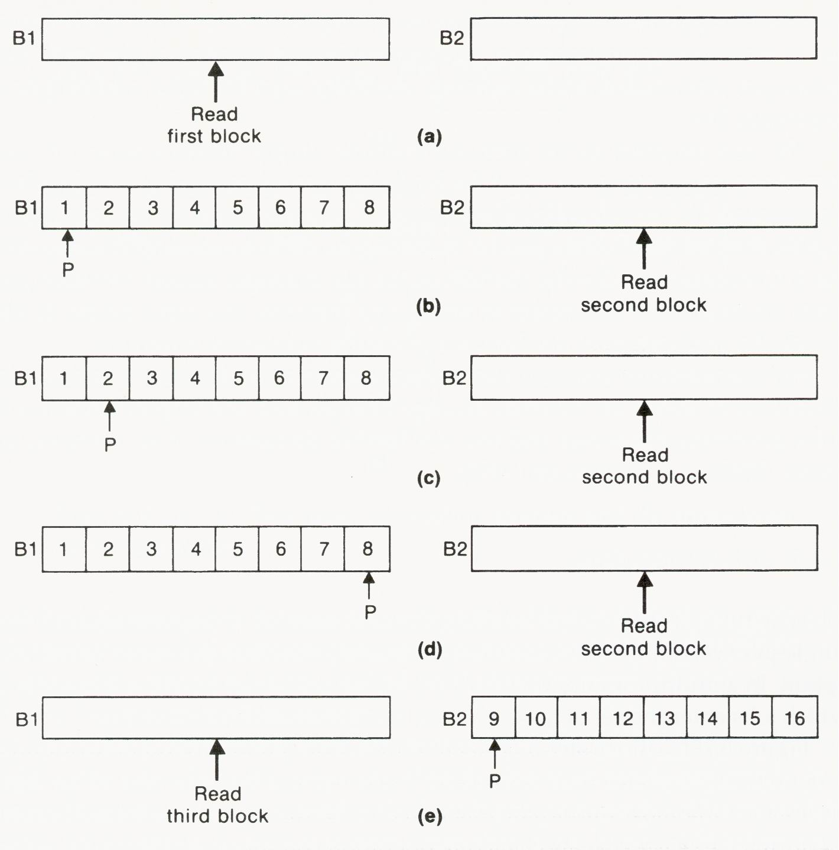
Double Buffering

Slide 4
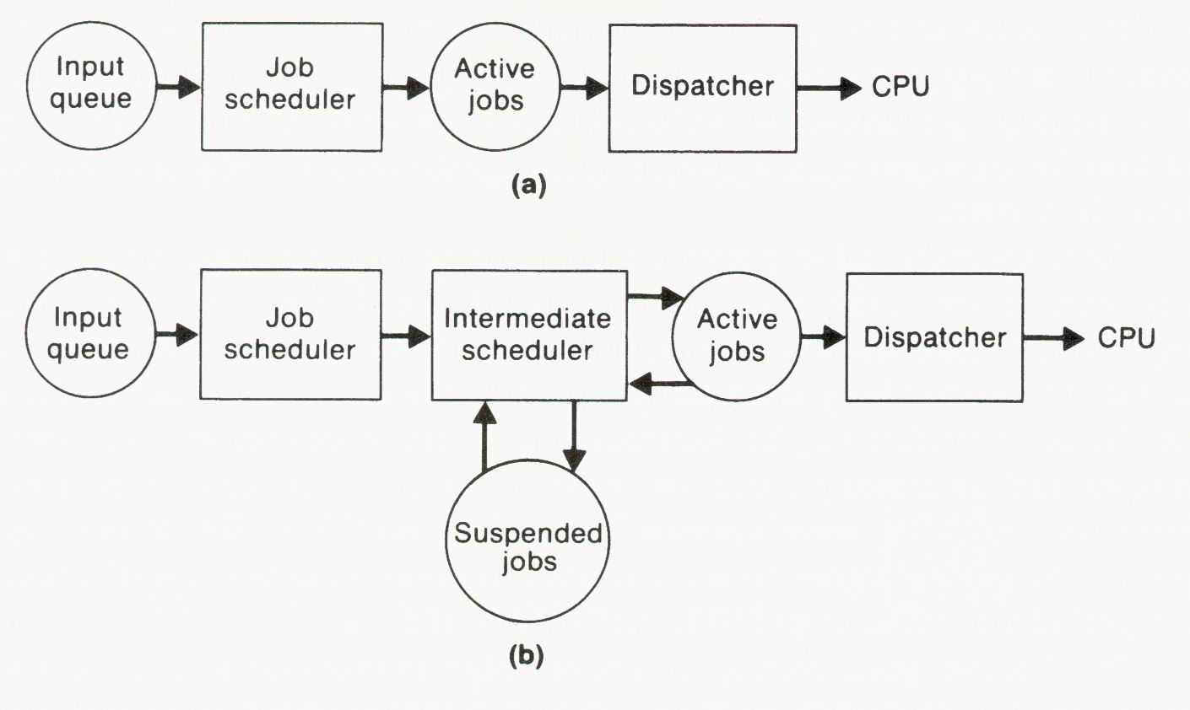
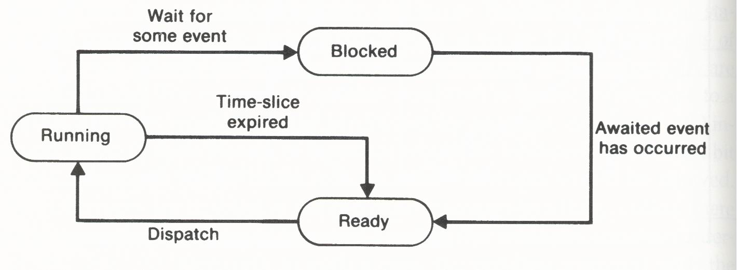
Job Scheduling
Two- and three-level scheduling systems
  Job scheduler: to increase the level of multiprogramming
  Intermediate scheduler: to dynamically decrease or increase the level of multiprogramming by monitoring the system performance

Slide 5
Goals of Job Scheduling
Maximum system throughput
  To perform the most computing work in the shortest time
Lowest average turnaround time
  To minimize the time between the submission and the completion of a job
  Shortest job first (SJF)
Lowest expected response time
  To minimize the time between entering a command and beginning to receive a response from the system.
  Round robin (RR)

Slide 6
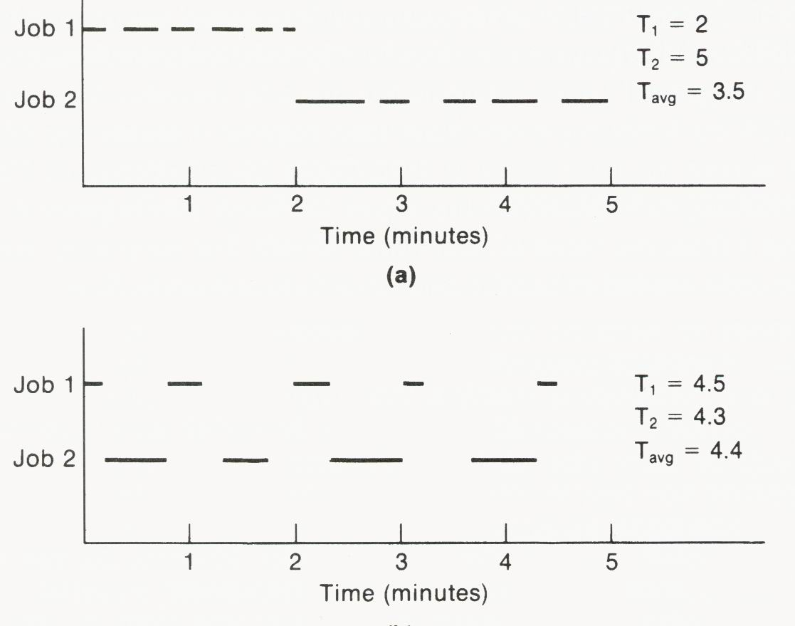
Throughput vs. Turnaround Time

Slide 7
Resource Allocation
In addition to memory, I/O, and CPU, OS provides general resource-allocation function that can be used to control the allocation of user-defined resources such as files and data structures.
If processes with shared resources are executed concurrently, they may or may not work properly.
Problems of this sort can be prevented by granting these processes exclusive control of shared resources.

Slide 8
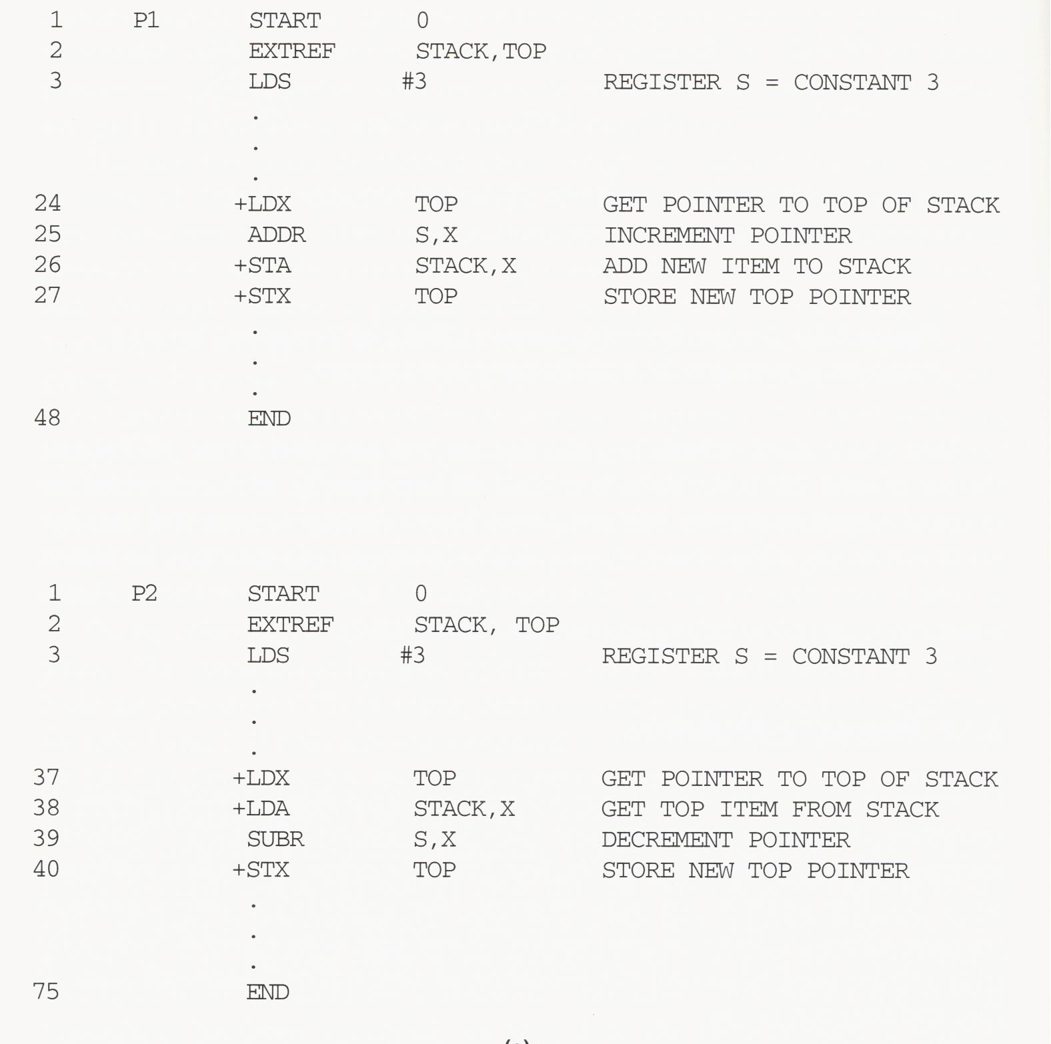
Resource Sharing

Slide 9
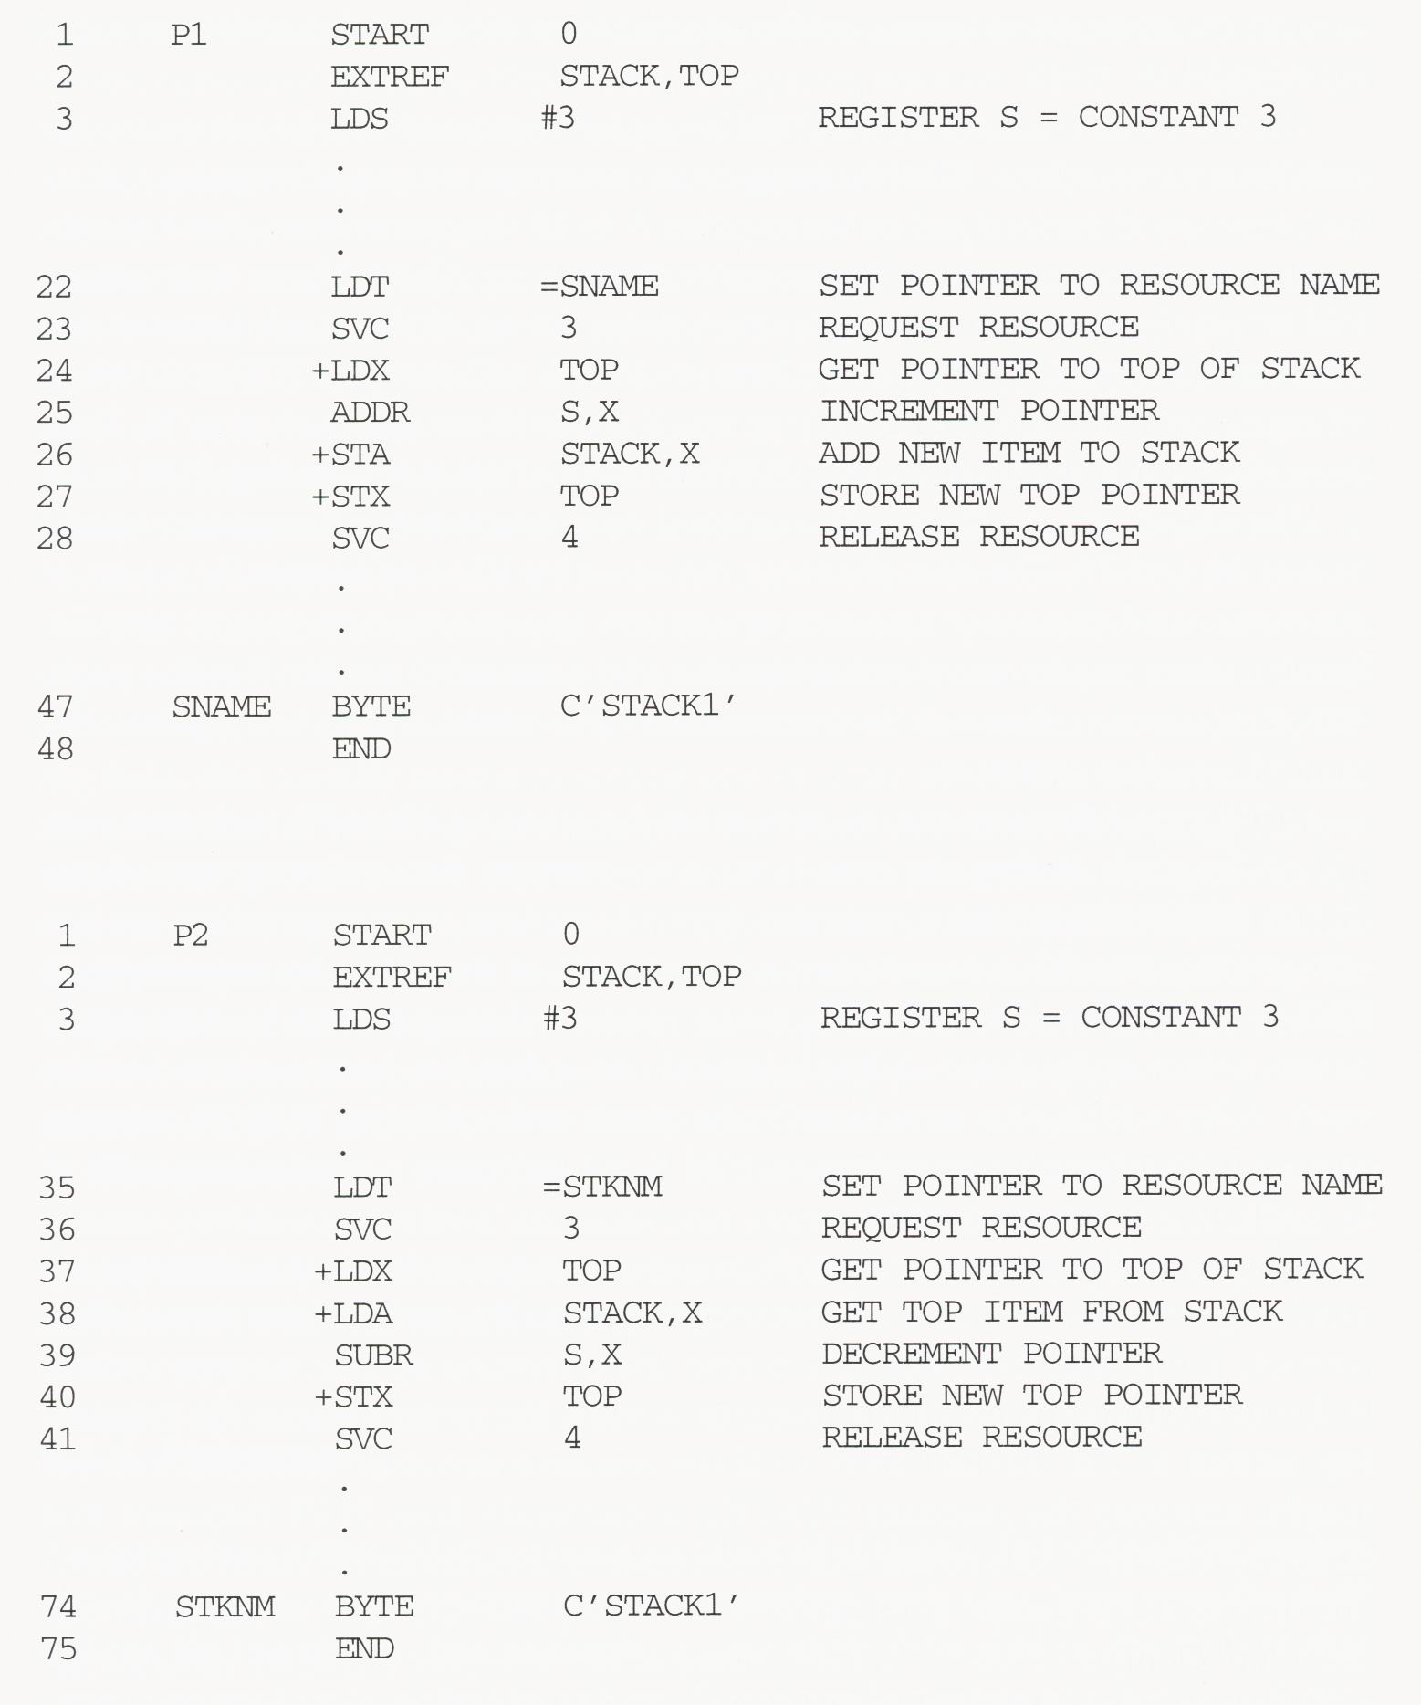
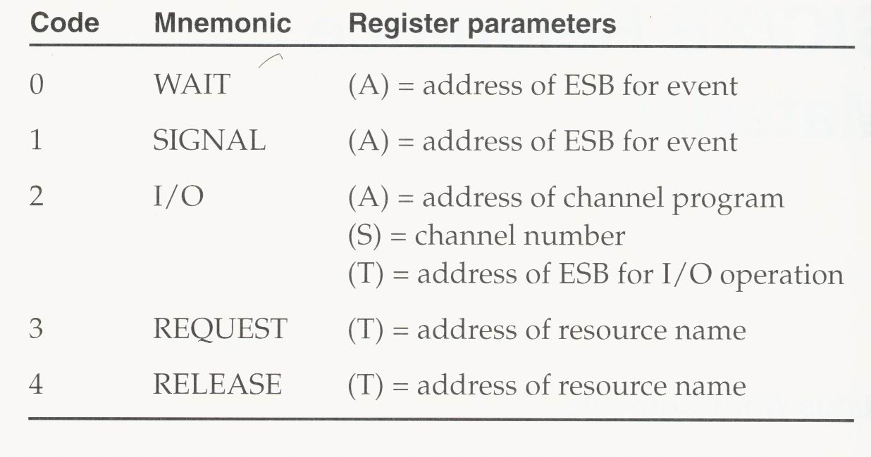
Resource Sharing with Exclusive Control
SVC

Slide 10
Process Synchronization
OS responds to a request for resource control:
  If the requested resource is free, OS returns control to the requesting process.
  If the resource is busy, OS places the requesting process in the blocked state until the resource becomes available.
The use of request and release operations can lead to another problem---deadlock:
  A set of processes each of which is permanently blocked because of resources held by the others.
P1
P2
P3

Slide 11
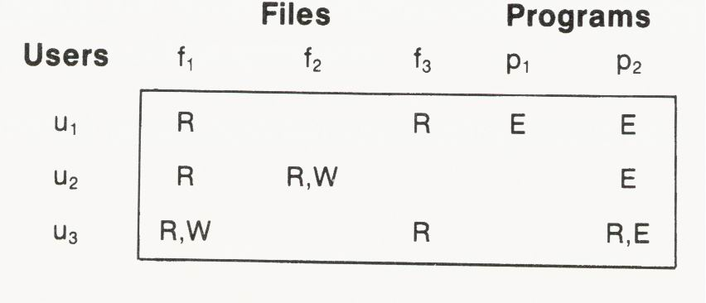
Protection
OS that serves a number of different users should provide some mechanism for protecting each user from unauthorized actions by the others.
Access control can be based on:
  Access matrix
  Authorization list
  Capability list
Capability list
Authorization list

Slide 12
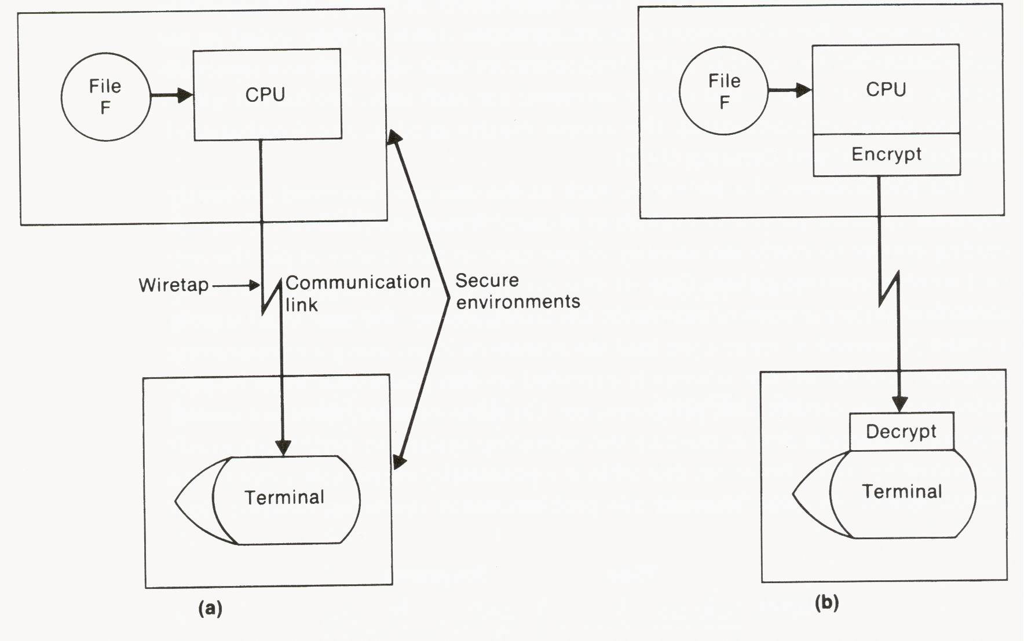
Security
User identification: password mechanism
Data protection: encryption and decryption

